Slide 1
Summer Internship Resources
Intern Orientation Framework
6 Week Employability Skills Curriculum
Summer Internship Program 2021

Slide 2
Suggestions for Use
This powerpoint contains curriculum ideas and resources for the Summer Internship Program. The resources offer guidance for an Intern Orientation of 1 full day or 2 half days, plus a 6-week Curriculum delivered by the intern coordinator over the course of the internship. The lessons in both the Orientation and 6-Week Curriculum are designed as stand-alone, interchangeable resources. Thus, the entire sequence may be used, or the units may be re-ordered or substituted based on the needs of individual counties and community partners.
Detailed facilitation tips are contained within the slide notes as well as in the accompanying Facilitation Guide.

Slide 3
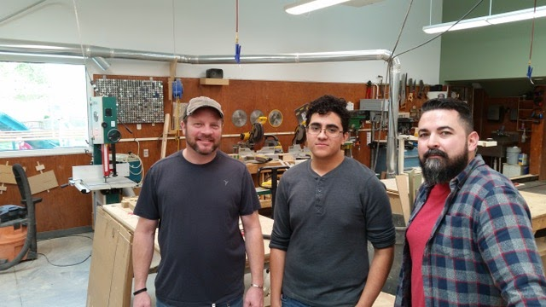
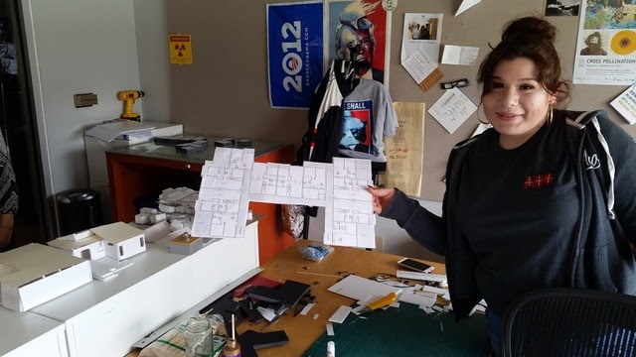
Learning
by
Doing!
Professional Mentorship
Caring Adults
Career Exploration

Slide 4
Intern Summer Orientation
Day 1
IceBreaker & Get to know you
Community building within cohort (Stereotypes of Work)
Boss your strengths
World of Work
Dream Job>>Skills/Experience>>Position Descriptions
Hopes & Fears

Slide 5
Iceberg Icebreaker
This is what you see about me:
Coworkers/teachers describe me as...
Things I like to do are…
Something I have accomplished is...
BUT if you really knew me….:
I am proud of…
My inner strengths are…
I am most passionate about….
What I love most about school/work is…
My biggest dream is...
The person I feel closest to is …
The most fun thing about me is…
Notes:
Context: begin by introducing the iceberg as a metaphor for how we show up in the work. That there are characteristics and behaviors about us and our identities that people see more apparently than others. Sometimes what people immediately see about us is a beautiful reflection of who we are and sometimes what people see (because of their own perceptions/experiences) doesn’t fully describe who we really are inside. Describe how this can come off as a first impression in the workplace or in an interview. Then describe how internship experiences are meant to be a learning experience for interns to more deeply explore who they are beneath the surface and grow their skills, inner characteristics, mindset and passions that may have been swimming deep within themselves under the surface.
Now have interns draw the iceberg on a piece of paper and use the prompts on the slide to have them name the attributes and characteristics of themselves above and below the surface. They do not need to answer every prompt as the prompts are meant to help spark their thinking.
Facilitate a round to share-out. Ask that each intern share one characteristic they named above the surface and one below the surface. “What you see about me is….But if you really knew me you would know….”

Slide 6
BOSS Your STRENGTHS*
Guide yourself to explore & unlock power skills and potential
Be an agent in your own skill development rather than just listening to lectures on work readiness.
Youth empowerment through the work experience.
Notes:
Boss your Strengths activity from MHA Labs
Warm-up: Ask interns to reflect on a time that they were faced with something challenging in their life and they were able to overcome that challenge. The challenge can be related to the workplace, school or personal life. Then have them briefly journal about what the challenge was and what steps they took to overcome it. Have them write down what they feel most proud about from overcoming that challenge (10min).
This self-reflective journaling will assist them in moving into the Boss Your Strengths activity with a positive growth mindset and with a specific example of a moment in their life where they leveraged their inner strengths to get through something new or difficult.
Share out with the group can be optional and dependent on the time allowable for the entire session
Have interns review the list of Power Skills on the Boss your Strengths worksheet and as they are reviewing the list have them circle the skills that they feel they already do well (5 min)
Have interns use the Boss your Strengths worksheet to identify their top 2 Power Skills and write evidence for how they demonstrate/have demonstrated that power skill before (5-10 min)
Ask interns to share out 1 of the 2 they wrote about. This can be done as a round for everyone’s voices to be heard and all strengths of the group named and honored or popcorn style if the group is too large to allow for all to share.
Finally, ask interns to review the list again and circle their top 3 Power Skills that they wish to learn/grow/practice more intentionally during their internship experience.

Slide 7
World of Work: Checking Assumptions*
Dream Job
KSA Knowledge, Skills, Attributes
YOUR Position Description: Fits & Questions?
Notes:
Think of a work setting or activity where you felt undervalued as a young person. With this program we are creating the conditions to ensure you are valued & respected as young person ready to contribute. We use the term “mentors” instead of “supervisors.” We believe in youth-adult partnerships rooted in respect.

Slide 8
Intern Summer Orientation
Day 2
Empathy Map
First Day Readiness:
Greetings & Intros, Small Talk, Active listening, Notes
Self care and stress management
Problem solving
Appropriate professional boundaries
Staying Safe, Reaching Out
Notes:
Appropriate prof boundaries: Creating conscious relationships activity- Grace

Slide 9
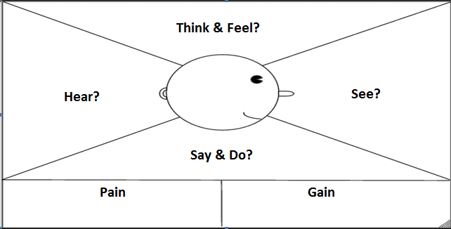
Imagine your first day at your internship.
What will you be:
Thinking?
Hearing?
Doing?
Feeling?
Notes:
This is our intern’s first day of her internship. Let’s explore what it would be like for her on her first day.
What do you think she is thinking and feeling?
What are some things that she is seeing at her internship?
What is she hearing? What are other professionals talking about? What is her mentoring telling her?
What do you think she is saying and doing on her first day?
What is the “pain” she might feel about this being her first day and first internship? What do you think she is anxious, nervous, afraid or worried about?
What does she have to gain from completing her internship? How is her courage to commit to this opportunity going to benefit her in the future?

Slide 10
Why is Stress Management and Self Care Important?
What stressful situations can you imagine coming up during your internship?
What are some reasons why self-care strategies are important when participating in your Internship (and in life)?

Slide 11
Self Care & Stress Management
Am I practicing enough self care?
Am I Practicing Enough Self Care?
Notes:
Ask interns to click on the link to do a quick self reflective self-care quiz. This is meant to help them gauge and get immediate fun feedback on how they may be doing and as a warm-up activity for the Give 1, Get 8 Self Care activity

Slide 12
Give 1 Get 8 Self Care Activity
How do you make time for exercise & what kind of exercise do you like to do? Have you had to make COVID safe changes to these? | What do you do during the week to nurture your spiritual health? | How do you carve out “me” time during your week and what do you do during that time?
How do you unwind and recharge at the end of a day? | How do you care for yourself after a stressful or upsetting day? | What are strategies you use to eat healthy during the day/week?
What are some morning routines that help you prepare physically, mentally and emotionally for the day? | What are your favorite activities that you do with friends &/or family that re-energizes you? | What is your favorite self-care activity that doesn’t fit into any of these boxes?
(Zoom annotation)
Notes:
Give interns 3-5 minutes to read over the prompts and pick 1 to journal about.
As a big group, go through each box and ask the interns who picked that box to share (verbally or in the chat) their answer
Annotate or type directly into this powerpoint their answers to collect them all. Screenshot the completed activity and email out to the group.

Slide 13
Internship Problem Solving Scenarios
Group 1: You wake up feeling a little sick. You really start to feel bad two hours before your internship starts. What are some steps you would take in deciding what to do next?
Group 2: Your family has decided to go out town suddenly to visit family in Texas. You know you have a busy week at your internship site and your mentor is counting on you to complete some key things. What do you do?
Group 3: Your car broke down this week and you need to be at your internship tomorrow afternoon. What are steps you would take to problem solve this situation?
What am I going to do!
Notes:
Facilitate small group discussions about each of these scenarios, allow interns to share out different approaches and things to keep in mind.

Slide 14
Staying Safe/ Reaching Out
It’s probably nothing.
I don’t want to BUG.
I wonder if this is happening to anyone else?
What if????
Should I ask about this!
Notes:
Consult with your respective county to determine what safety and compliance requirements they see as essential to include in the onboarding process & orientation process. Design activities to meet these needs.

Slide 15
END of ORIENTATION TOPICS
BEGIN 6 WEEK CURRICULUM UNITS

Slide 16
6 Week Internship Curriculum Units
Workplace Culture: Observing & navigating.
Self Organization & Management
Giving & Receiving Feedback (Self-Advocacy)
Communication & Problem Solving: Righting Wrongs & growing through Setbacks
Be That Boss!
Professional Pathways & Closure: What’s your Story?
Notes:
Reminder: These units may be re-ordered, substituted for, modified, or deleted depending on the county’s and partner’s needs.

Slide 17
Suggested Daily Lesson Plan for Session
Check in Activity
Glows & Grows - review the prior week: what went well, where is potential for growth?
Hours & Mentor feedback review
Main Workshop Activity
Plan for upcoming week--connect topics covered to the work setting.

Slide 18
Week 1: Workplace Culture
strategies for observing and navigating
Check In Activity
Cultural Anthropologist: Observation Activity
Generations in the workplace
Conscious Relationship Norms
Role of Mentors
Individual coworker interviews
Notes:
https://docs.google.com/document/d/1zsnxXH9vJqX2KErumieWKcwwPSbcaiquabM2F-KcoSk/edit#bookmark=id.80j8vvqv5tfe

Slide 19
Week 2: Self Organization & Task Management
staying on top of life and internship
Check in Activity
Review Professional Emails
Discussion: What do you notice, wonder and questions
Components of an email
Create a professional email account
Write professional email
Receive feedback from three peers.
Responding to emails in the workplace
Virtual meeting spaces
Create zoom account
Schedule meeting with intern
Scavenger Hunt
Notes:
https://docs.google.com/document/d/1zsnxXH9vJqX2KErumieWKcwwPSbcaiquabM2F-KcoSk/edit#bookmark=id.u6d7fhpku4if

Slide 20
Week 3: Giving & Receiving Feedback
advocating for yourself
Boss Your Feedback
Check in Activity
Advocating for Yourself
What does this look like for you?
Why is this important?
How does this look in a work setting?
Role playing scenarios
Affirmations and acknowledgement of colleagues and yourself
Giving/Receiving Feedback
Self-critique/reflection
Notes:
https://docs.google.com/document/d/1zsnxXH9vJqX2KErumieWKcwwPSbcaiquabM2F-KcoSk/edit#bookmark=id.jrr73yg5dcn2

Slide 21
Week 4: Navigating life’s little bumps
righting wrongs & growing through setbacks
Boss Your Growth
Purpose of the Internship is for learning
Learning from your mistakes
Righting your wrongs
Reflection is a strength
Challenge your action and not personalize it
Notes:
https://docs.google.com/document/d/1zsnxXH9vJqX2KErumieWKcwwPSbcaiquabM2F-KcoSk/edit#bookmark=id.6qtyztqzn7ij

Slide 22
Week 5: Be that Boss!
tips on how to be a great leader & a great teamplayer
Check in Activity
What makes a leader?
Identify your strengths as a leader
Update resume with strengths
Build a project together
Egg Drop
Connection to excelling as a team player
Revisit Conscious Relationship
Notes:
https://docs.google.com/document/d/1zsnxXH9vJqX2KErumieWKcwwPSbcaiquabM2F-KcoSk/edit#bookmark=id.wx5n1auamf3a

Slide 23
Week 6: What’s Your Story?
professional interviewing for interns to learn about mentor’s journey
Check in Activity
Interviewing Skills
Active listening
Elevator pitch
Pair and Practice
Conversational Skills
Interviewing Professionals - Preparation required in earlier weeks.
Notes:
https://docs.google.com/document/d/1zsnxXH9vJqX2KErumieWKcwwPSbcaiquabM2F-KcoSk/edit#bookmark=id.odkhrtk5t2y

Slide 24
Important / FAQs to Cover
Attendance & Communication & Confidentiality
Appearance (in person & virtually)
COVID-19 Workplace Safety Practices
Individual Assessment: clothing, transportation, technology
Coordinator Contact & Mentor Contact

Slide 25
Example Position Description in Next Slide as Reminder to include in activity somewhere if available.

Slide 26
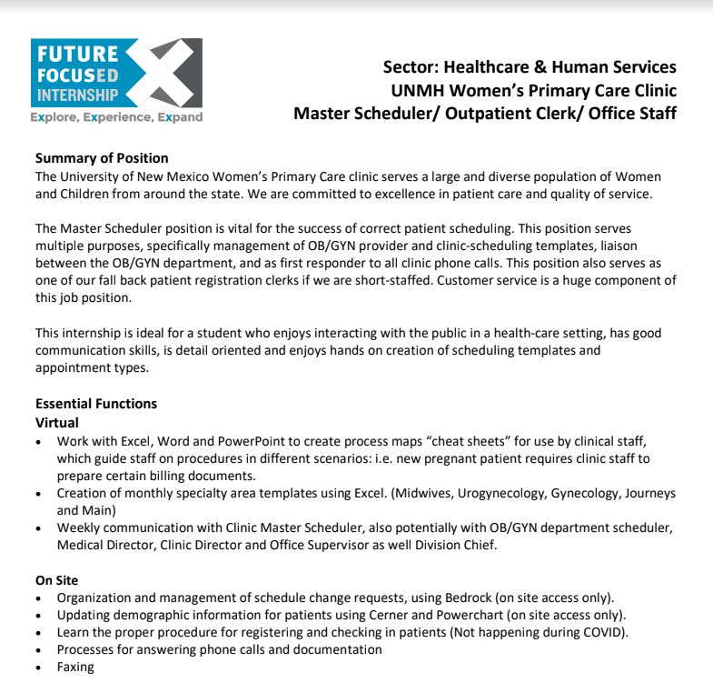

Slide 27
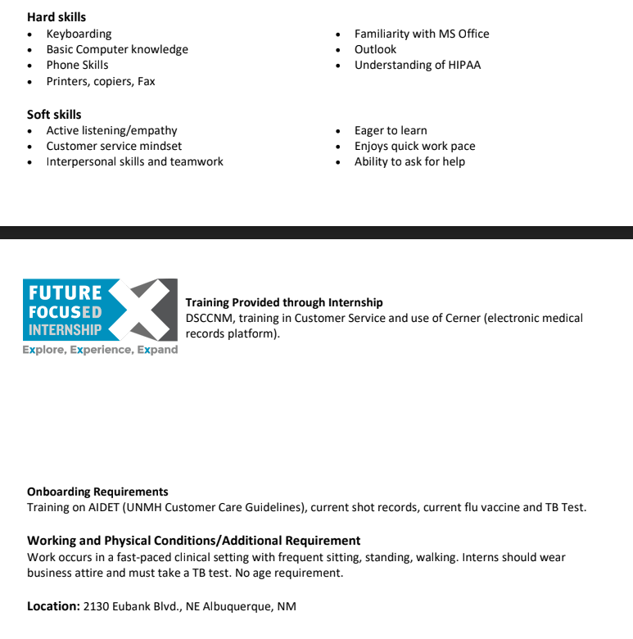

Slide 28
End of Intern & 6 week Curriculum
Slide Show

